Slide 1
Political Violence in Weimar
Geospatial Data and animated maps

Slide 2
Major Issues
Biggest problem is navigating historical data in a different language
Lots of shapefiles
None of them matched up
Annoying
tmap_animate
ImageMagick
Absolutely refusing to work
Magically working

Slide 3
Some Minor Issues
QGIS
Georeferencing
Coordinate Reference Systems

Slide 4
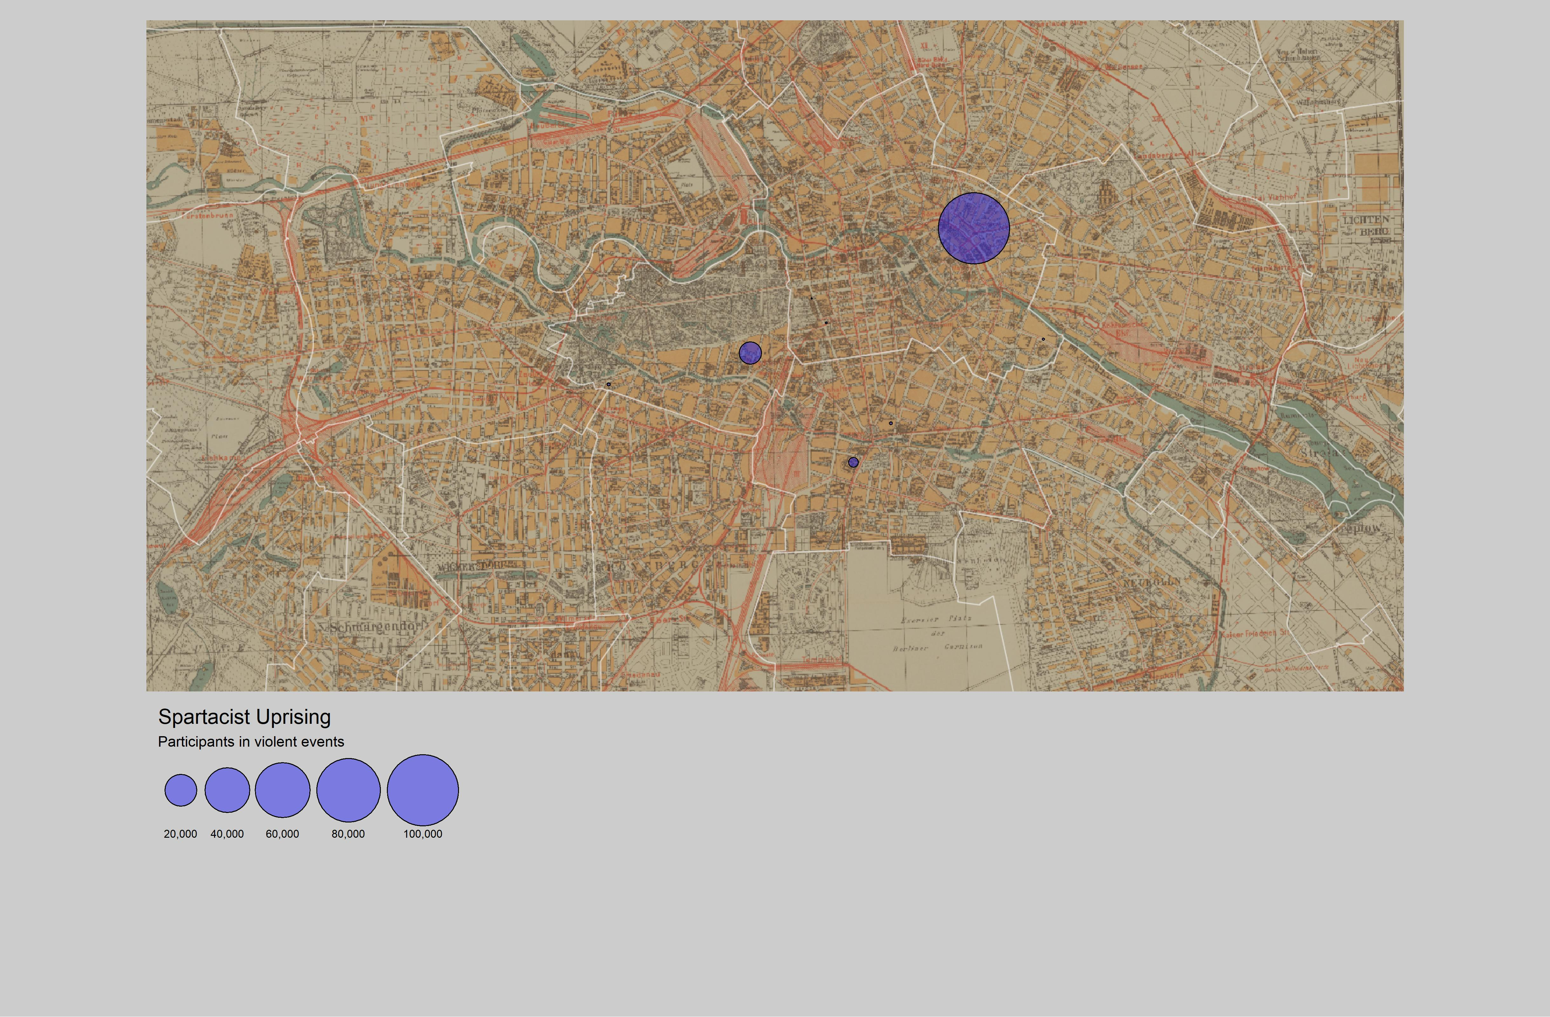
Spartacist Violence
Made with QGIS and tmap

Slide 5
Major violent events in the Weimar
Theoretically this will be a gif

